Slide 1
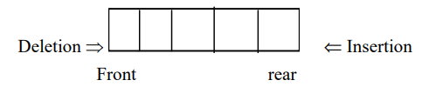
Queue
A queue is an ordered collections of items from which items may be deleted at one end called the front of the queue and in to which items may be inserted at the other end called rear of the queue.
Since, it is always the 1st item to be put into the queue and that is the 1st item to be removed , a queue is FIFO list. The front and rear are also called head and tail respectively.

Slide 2
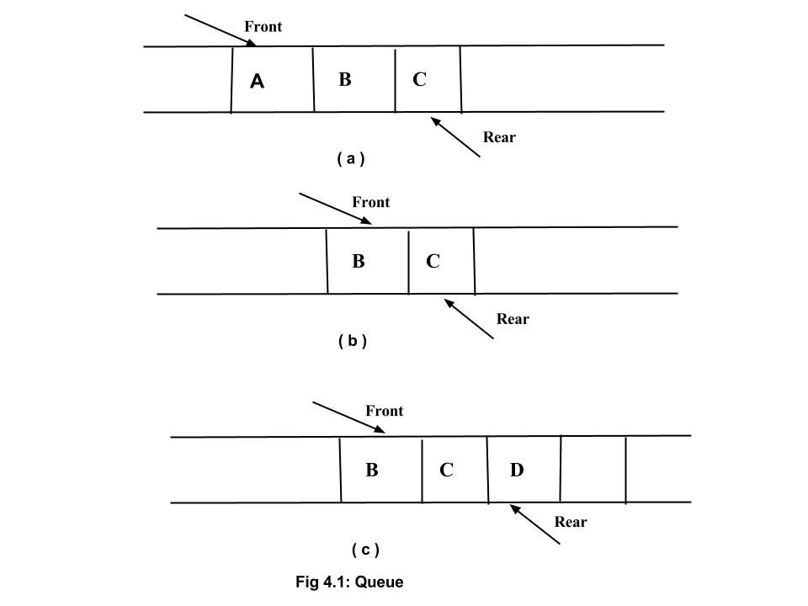

Slide 3
Application of Queue
The queue is very useful in various field of computer science. The real time application of queue are as follows:
Familiar applications.
iTunes playlist.
Data buffers
Asynchronous data transfer (file IO, pipes, sockets).
Dispensing requests on a shared resource (printer, processor).
Simulations of the real world.
Traffic analysis.
Waiting times of customers at call center.
Determining number of cashiers to have at a supermarket

Slide 4
Queue as an ADT
A queue is the order collection of items, where an item to be added to the queue must be placed at the end of queue and items to be removed must be removed from the front.
The end of the queue is known as rear and the front of the queue is known as front.
The term enqueue means to add an items to the queue and the term dequeue means to remove an item from the queue.
Operation of queue:
Enqueue (5,x): to insert an item, x at the rear of the queue.
Dequeue(queue): if the queue is not empty, remove the element from the front of the queue.
Front (queue) : access the first item at front of queue.
IsEmpty(queue ): Determine whether queue is empty or not. Return true if it is empty else false.
IsFull(queue) : Determine whether queue is full or not. Return true if it is full else false. (Note: Is Full is only used if it is implemented using array to check upper bound)

Slide 5
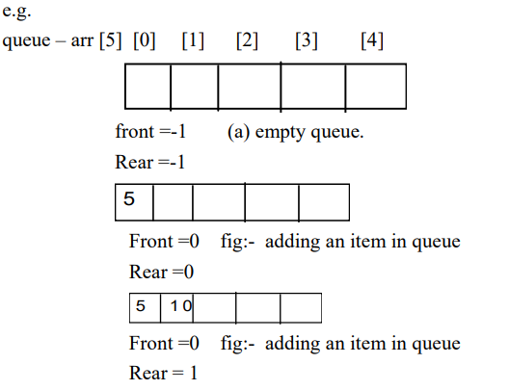
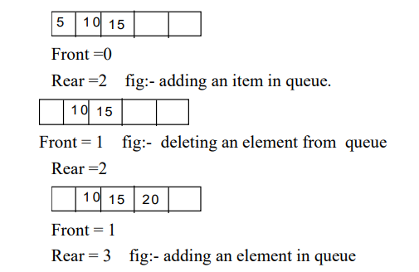

Slide 6
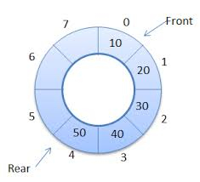
Circular Queue
A circular queue is the collection of element in which the insertion of new element is done at the very first location of the queue if the last location is full.
If we have a queue of n elements, then after inserting an element in last location i.e n-1th position of the array, very first location ie 0th position of the array.

Slide 7
Linear Queue
In linear queue when an element is inserted, rear is incremented and when an element is deleted front is incremented.
But in linear queue , there is problem of space utilization which is overcome by the circular queue.
In below figures of linear queue and circular queue, it is clearly seen that if we try to insert a new element in the linear queue, it doesnot allowed to do so and given message queue is full or overflow, even location Q[0] through Q[2] is empty. But in circular queue if we insert a new element it will be inserted in Q[0] location as it is empty. This is why, circular queue is better than linear queue.

Slide 8
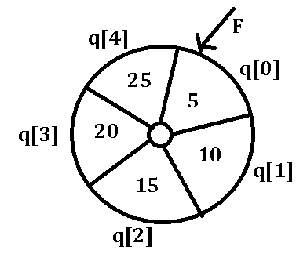
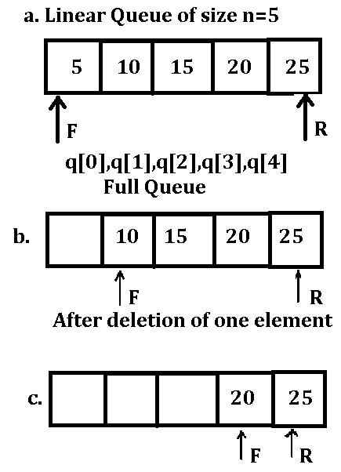
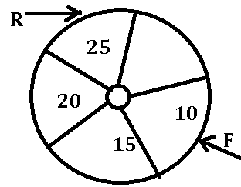
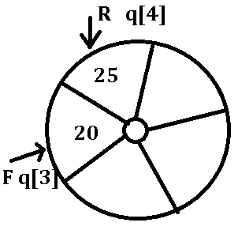

Slide 9
Priority Queue:
It is collection of elements such that each element has been assigned a priority and the order in which elements are deleted and processed comes from the following rules:
An element of higher priority is processed before any element of lower priority.
Two element of same priority are processed according to the order they were added to the queue.
There can be two types of priority queue:
Ascending Priority Queue
Descending Priority Queue

Slide 10
Priority Queue:
Ascending priority Queue is the collection of items into which items can be inserted and from which only the smallest item can be removed. On the other hand Descending priority queue allows only the large item to be removed.
Priority Queue are mostly used in CPU scheduling. The process with short processing times are given higher priority and processes with longer processing times are given low priority.

Slide 11
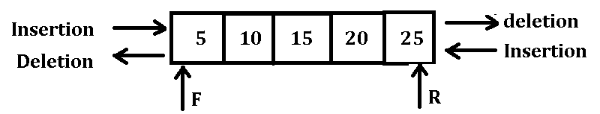
Double Ended Queue
It is the collection of elements in which insertion and deletion operation are performed from both the ends ie. We can insert from rear end or from the front end.
Operation of DeQUE:
Insert element at the rear of the queue
Insert element at the front of the queue.
Delete element from the rear of the queue
Delete element from the front of the queue

Slide 12
Enqueue(queue[maxsize/5], item)
Step 1: intialize front=-1,rear=-1
Step 2 : Repeat step 3 to step 5 until Rear<max-1
Step 3:Read item.
Step 4: if front=-1 then
Front=0
Rear = 0
Else
Rear= rear+1
End if
Step 5: set queue[rear]=item
Step 6: print “queue overflow”

Slide 13
Dequeue(queue[maxsize],item]
Step:1 Set front=0
Step 2: Repeat step 3 to step 4 until front>=0
Step 3: if front=rear
Set front=-1
Rear=-1
Else
Front=front+1
End if
Step 4: print “ item deleted is “ item
Step 5: print “queue is empty”

Slide 14
Dynamic memory allocation:- In an array it is necessary to declare the size of array. This creates two possible problems.
1. If the records that are stored is less than the size of array, then there is a wastage of memory.
2. If we want to store more records then size of array, we can’t store.
To overcome these problem we use dynamic memory allocation. The functions used for dynamic memory .
The functions used for dynamic memory allocation and deallocaton are :- Malloc(), Calloc(), Free(), Realloc()
Malloc():- This function is used to allocate memory space. The malloc () function reserves a memory space of specified size and gives the starting address to the pointer variable.
Syntax:- Ptr = (data type * ) malloc (specified size)
Type of pointer size required to reserve in memory.
int *(address) malloc(20)

